Slide 1
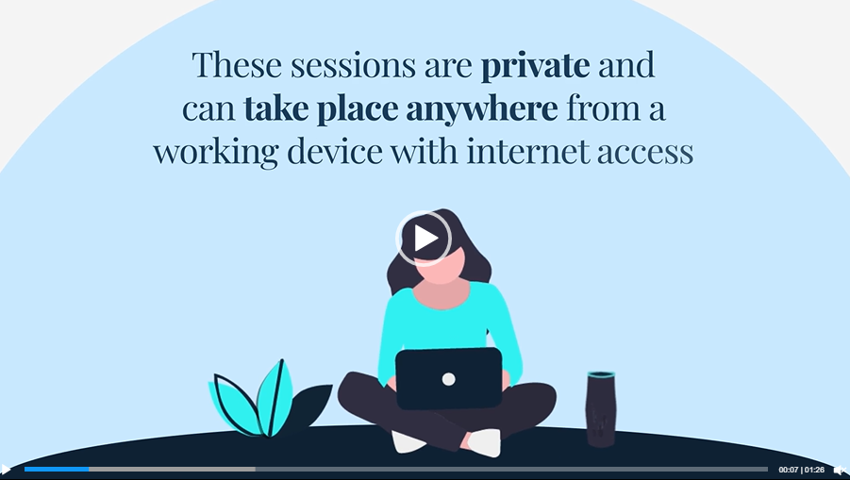

Inspiration & Examples
Creating a
Landing Page
on Your Website
University of Idaho
Florida International University
            Care Resource Center
University of Portland
SkidMore College
Resource Center – Navigation Menu
Having a dedicated landing page on your counseling website provides a centralized hub for program information, but also establishes trust with your students.
Highlighting the program on multiple Institutional webpages increases the visibility and awareness of these services.
Embed "How To Register" Video

Slide 2

BUILDING YOUR CAMPUS PROMO TOOLKIT
How to Register (In Less Than 5-Minutes)
Share this Video
Click the link here to get started!
Hit the share button in the video description.
Choose the option that suits you best.
Embed Code
<iframe src="https://player.vimeo.com/video/954490031?h=8b93edd06c&autoplay=1&loop=1" width="640" height="360" frameborder="0" allow="autoplay; fullscreen; picture-in-picture" allowfullscreen></iframe>
<p><a href="https://vimeo.com/954490031">How to Register (In Less Than 5-Minutes)</a> from <a href="https://vimeo.com/user201805583">BetterMynd</a> on <a href="https://vimeo.com">Vimeo</a>.</p>
.

